Slide 1

Graphical User Interface Using Tkinter in Python

Slide 2
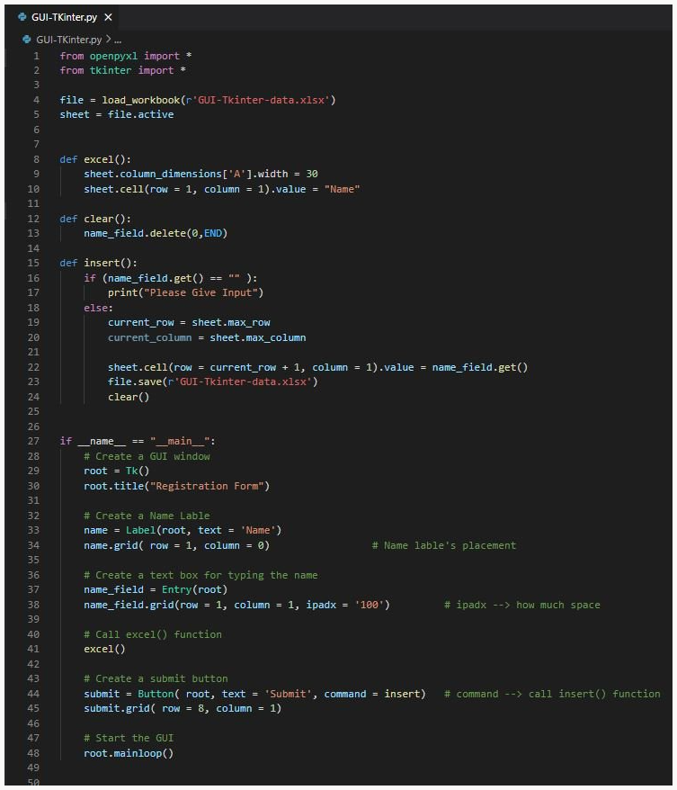
Create an empty excel sheet "GUI--Tkinter-data.xlsx"
Install openpyxl in Python <pip install openpyxl>
--> For opening excel file
3. Install tkinter in Python <pip install tk>
--> For creating GUI
Concepts:
Create a GUI <__main__>
Root title--> GUI title "Registration Form"
1st line --> Lable : "Name", and its field (for user input)
2nd line - center --> Submit Button
In excel Sheet
1st row – 1st column --> column Name "Name" <excel()>
After clicking submit button (Every time its run) <insert()>
Next row – 1st column --> Store user inputs

Slide 3
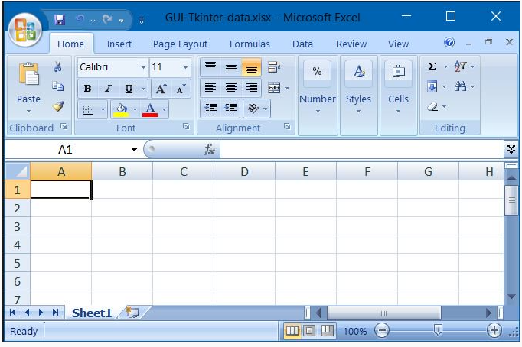
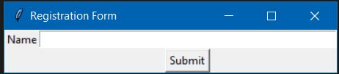
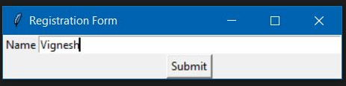
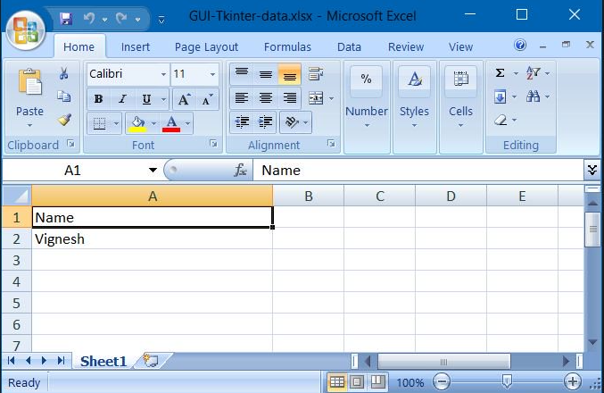
Before Run Snippet : GUI-Tkinter-data.xlsx
Running : GUI
<__main__>
Type and click submit button
<__main__>
<insert()>​
open the excel file
After Submit
After Run Snippet : GUI-Tkinter-data.xlsx
<clear()>
<insert()>​

Slide 4
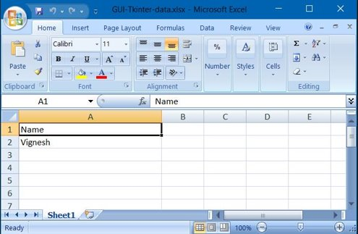
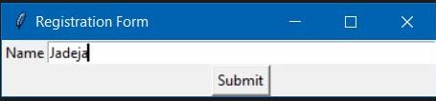
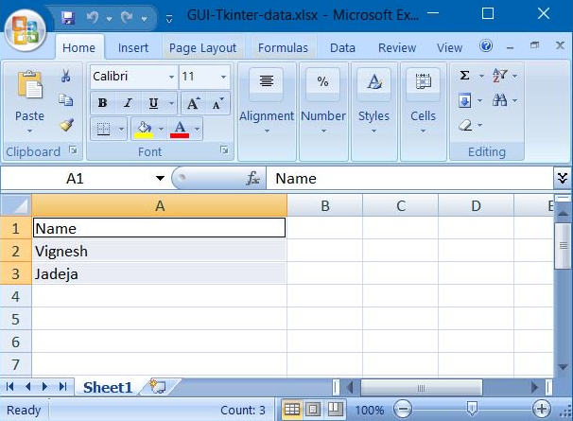
Before Run Snippet : GUI-Tkinter-data.xlsx
Running : GUI
<__main__>
Type and click submit button
<__main__>
open the excel file
<insert()>​
After Run Snippet : GUI-Tkinter-data.xlsx
After Submit
<clear()>
<insert()>​

Slide 5
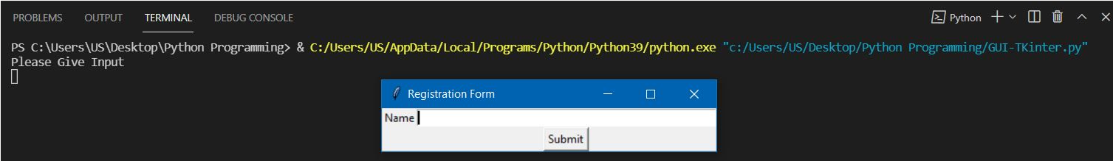
If you click submit button without giving text, it will show message like "Please Give Input"

